Slide 1


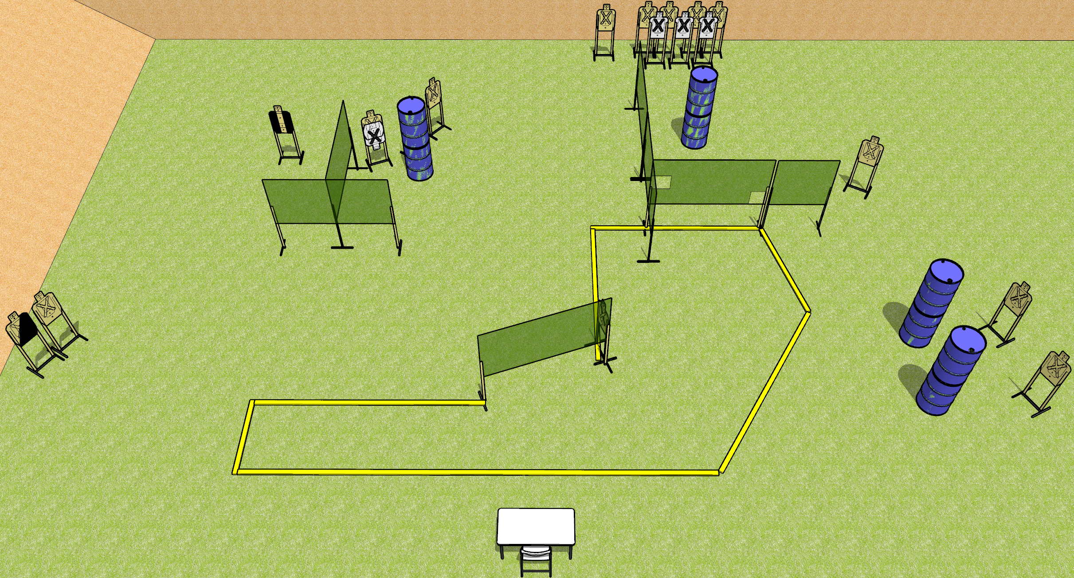
 | Dothan Gun Club – USPSA Match Load ‘em Up Course Designer : Drew Coleman
START POSITION : Sitting in chair, feet flat on ground, back against seat back, hands touching outermost left and right marks, palms flat.
GUN READY CONDITION : firearm is unloaded with trigger guard on either black mark, laying unsupported. First magazine for stage is placed on other black mark. |  | SCORING: Comstock, 30 rounds TARGETS: 15 paper, 0 Steel SCORED HITS: Best 2 on paper, steel until down START-STOP: Audible, last shot RULES:
STAGE PROCEDURE: Engage targets as they become available from within the fault lines.

Slide 2
Load ‘em Up
Written Stage Briefing
Load ‘em Up is a 30 round, 150 point, Comstock field course. There are fifteen USPSA targets. The best two hits on paper will score. The start signal is audible.
Start position is seated in chair, feet flat on ground, back against seat back. Hands are palms flat on table, touching outermost left and right marks. Firearm is unloaded with trigger guard on either inner mark, unsupported. First magazine to be used is laying on the other inner mark. All other magazines may come from belt.
On start signal, engage targets as they become available from within the shooting area.

